Slide 1

ML using Python Session 3
Nabajyoti Pathak
Data Scientist,

Slide 2
Agenda
Introduction to Machine Learning
Data Preprocessing
Creating Validation rules

Slide 3
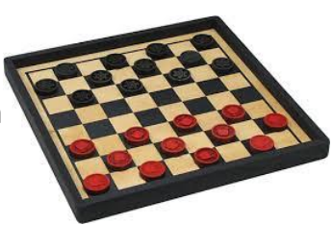
1. Introduction to Machine Learning
Arthur Samuel (1959): Machine Learning is the field of study that gives computers the ability to learn without being explicitly programmed.
Samuel Checkers-playing program is the world's first self-learning program

Slide 4

What is Machine Learning ?
Tom Mitchell (1998): A computer program is said to learn from experience E with respect to some task T and some performance measure P, if its performance on T, as measured by P, improves with experience E.
Example :Filtering spam emails

Slide 5

Application??
Can you think and give one application of ML in your daily life???

Slide 6
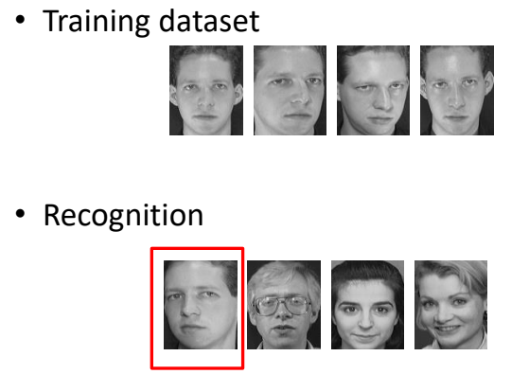
Applications (Face Reorganization)

Slide 7
Types of Machine Learning Techniques
Supervised :-
Classification
Regression
Unsupervised
Clustering
Outlier detection
Reinforcement

Slide 8
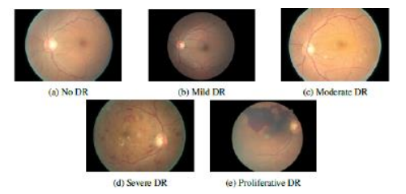
Supervised Learning
Supervision: The training data (observations , measurements, etc.) are accompanied by labels indicating the class of the observations
New data is classified based on the training set
Example:

Slide 9
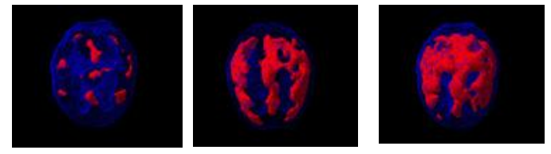
Unsupervised Learning
The class labels of training data is unknown
Given a set of measurements and observations, the aim is to establish the existence of classes or clusters in the data
Example: understand patterns of brain activity

Slide 10
Reinforcement Learning
Reinforcement learning is an area of Machine Learning. It is about taking suitable action to maximize reward in a particular situation.
It is employed by various software and machines to find the best possible behavior or path it should take in a specific situation.
Reinforcement learning differs from the supervised learning in a way that in supervised learning the training data has the answer key with it so the model is trained with the correct answer itself whereas in reinforcement learning, there is no answer but the reinforcement agent decides what to do to perform the given task. In the absence of training dataset, it is bound to learn from its experience.

Slide 11
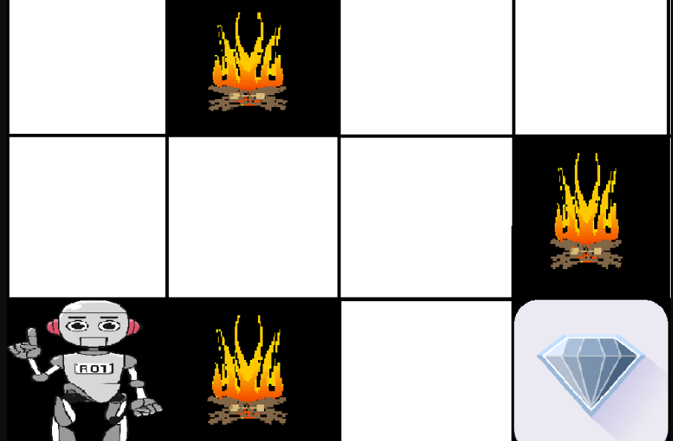
Example
The problem is as follows: We have an agent and a reward, with many hurdles in between. The agent is supposed to find the best possible path to reach the reward.

Slide 12
Difference between Reinforcement learning and Supervised learning:
REINFORCEMENT LEARNING | SUPERVISED LEARNING
Reinforcement learning is all about making decisions sequentially. In simple words we can say that the out depends on the state of the current input and the next input depends on the output of the previous input | In Supervised learning the decision is made on the initial input or the input given at the start
In Reinforcement learning decision is dependent, So we give labels to sequences of dependent decisions | Supervised learning the decisions are independent of each other so labels are given to each decision.
Example: Chess game | Example: Object recognition

Slide 13
Various Practical applications of Reinforcement Learning
RL can be used in robotics for industrial automation.
RL can be used to create training systems that provide custom instruction and materials according to the requirement of students.

Slide 14
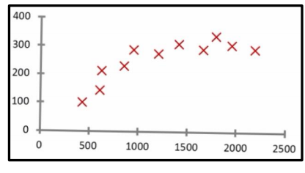
Regression Problem
An approach for modeling relationship between variables, where changes in some variables may “explain” or possibly “cause” changes in other variables
Regression problem: Predict continuous valued attributes

Slide 15
Regression Problem
Explanatory variables are termed the independent variables (generally represented in the horizontal axis as variable x)
Variables to be explained are termed the dependent variables (generally represented in the vertical axis as variable y)
Simple Regression: A field in regression where only one independent variable and one dependent variable are considered

Slide 16
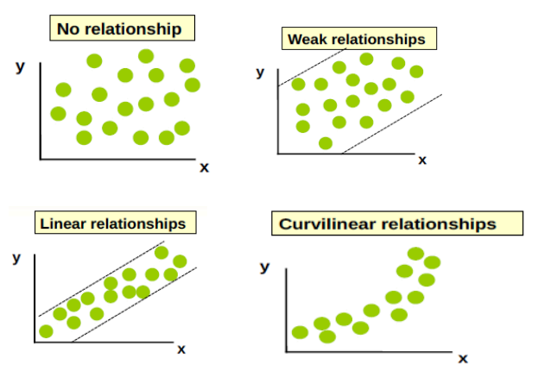
Type and Intensity of the Relationship

Slide 17
Classification Problem
Predicts categorical class labels (discrete valued output)
Classifies data (constructs a model) based on the training set and the values (class labels) in a classifying attribute and uses it in classifying new data

Slide 18
Assignement
Classification or Regression Problem
Predict the share prices for market analysis
Finding the suitability of a customer for credit card approval
Predicting the movement of a cyclone
Finding earthquake damaged areas from satellites images.
Predicting the number of fraud UBER drivers
Predicting if a kidney cell is malignant.
Predicting the distance an uber driver will cover in a day.
Predicting the mail is spam.

Slide 19
2. Data Preprocessing
Cleaning data
● Prepare data for analysis
● Data almost never comes in clean
● Diagnose your data for problems

Slide 20
Common data problems
Inconsistent column names
Missing data
Outliers
Duplicate rows
Untidy
Need to process columns
Column types can signal unexpected data values

Slide 21
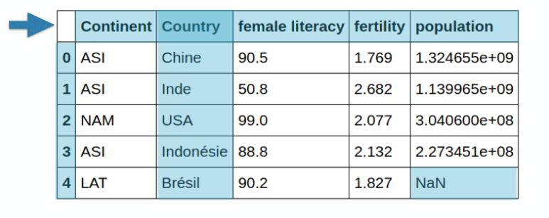
Unclean data
Column name inconsistencies
Missing data
Country names are in French

Slide 22
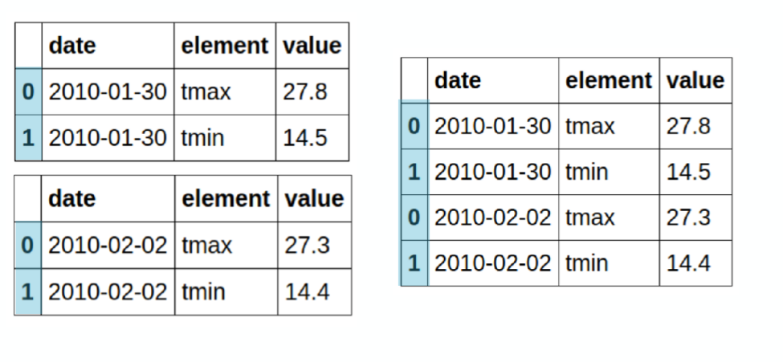
Concatenation

Slide 23
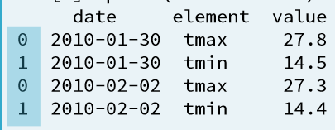
pandas concat
In [1]: concatenated = pd.concat([weather_p1, weather_p2])
In [2]: print(concatenated)

Slide 24
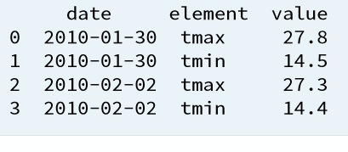
pandas concat
In [4]: pd.concat([weather_p1, weather_p2], ignore_index=True)
Out[4]:

Slide 25
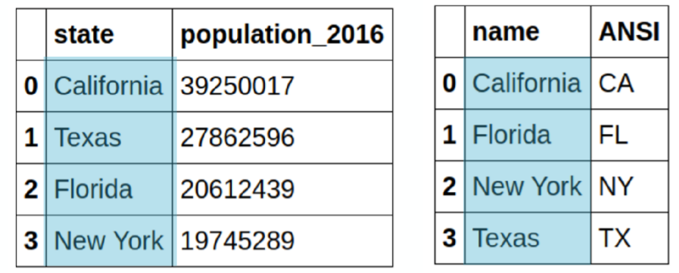
Combining data
Concatenation is not the only way data can be combined

Slide 26
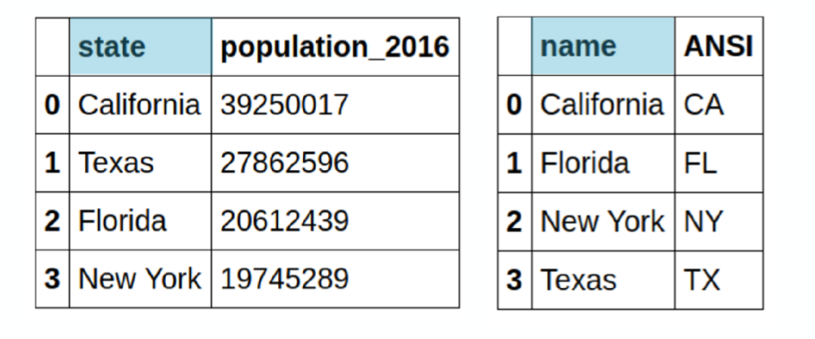
Merging data
Similar to joining tables in SQL
Combine disparate datasets based on common columns

Slide 27
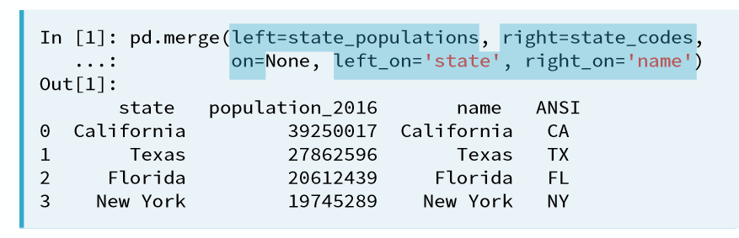
Merging data

Slide 28
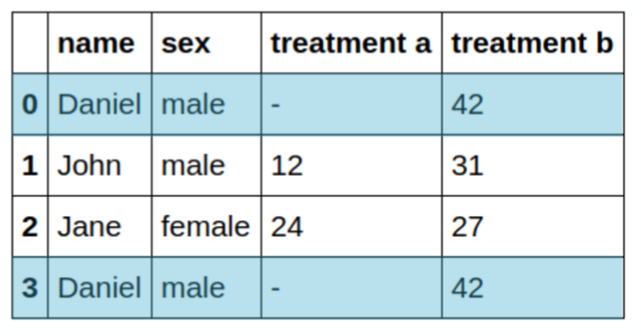
Duplicate data
Can skew results
‘.drop_duplicates()’ method

Slide 29
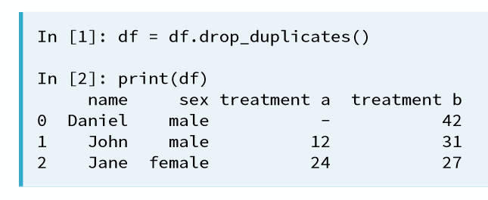
Drop duplicates

Slide 30
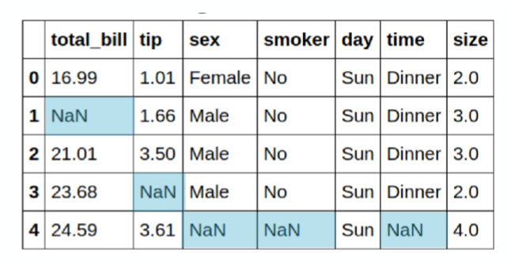
Missing data
Leave as-is
Drop them
Fill missing value

Slide 31
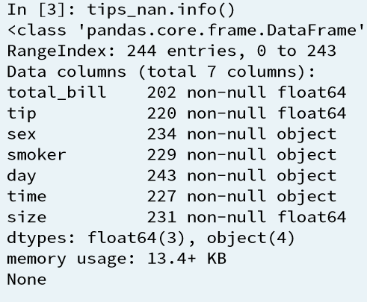
Count missing values

Slide 32
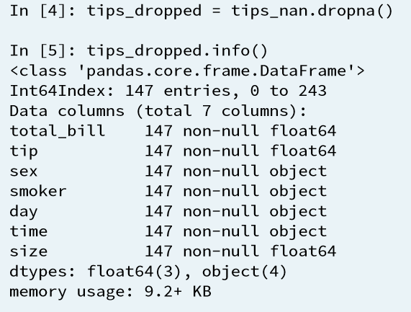
Drop missing values

Slide 33
Fill missing values with .ﬁllna()
Fill with provided value
Use a summary statistic

Slide 34
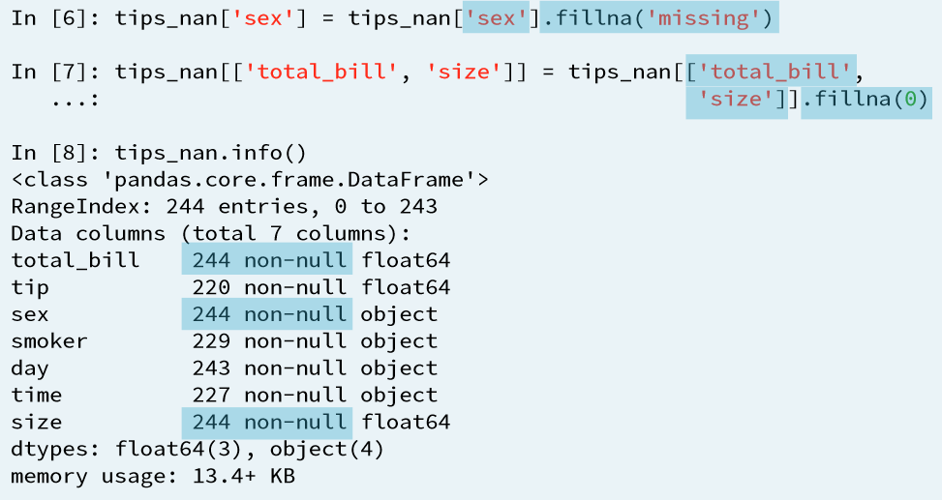
Fill missing values

Slide 35
Fill missing values with a test statistic
● Careful when using test statistics to ﬁll
● Have to make sure the value you are ﬁlling in makes sense
● Median is a better statistic in the presence of outlier

Slide 36
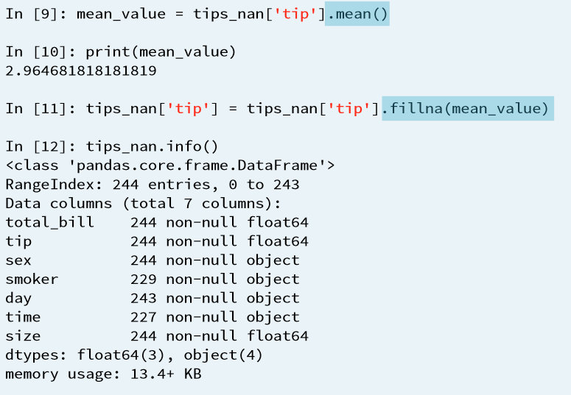
Fill missing values with a test statistic

Slide 37
Useful methods
In [1]: import pandas as pd
In [2]: df = pd.read_csv('my_data.csv')
In [3]: df.head()
In [4]: df.info()
In [5]: df.columns
In [6]: df.describe()
In [7]: df.column.value_counts()
In [8]: df.column.plot('hist')

Slide 38
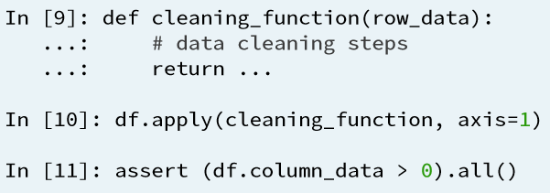
Data quality

Slide 39
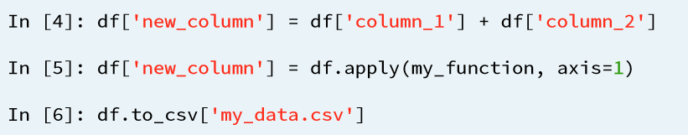
Additional calculations and saving your data

Slide 40
3. Creating Validation rules
What is Cross Validation?
Cross Validation is a technique which involves reserving a particular sample of a dataset on which you do not train the model. Later, you test your model on this sample before finalizing it.

Slide 41
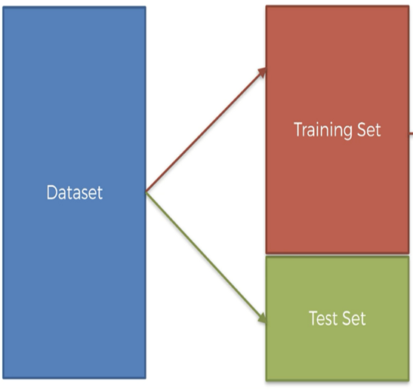

Slide 42
Steps involved in cross validation
You reserve a sample data set
Train the model using the remaining part of the dataset
Use the reserve sample of the test (validation) set. This will help you in gauging the effectiveness of your model’s performance.
If your model delivers a positive result on validation data, go ahead with the current model.

Slide 43
Common methods used for Cross Validation
The Validation set Approach
Leave out one cross validation (LOOCV)
k-fold cross validation
Stratified k-fold cross validation

Slide 44
The validation set approach
In this approach, we reserve 50% of the dataset for validation and the remaining 50% for model training.
However, a major disadvantage of this approach is that since we are training a model on only 50% of the dataset, there is a huge possibility that we might miss out on some interesting information about the data which will lead to a higher bias.

Slide 45
Leave one out cross validation (LOOCV)
In this approach, we reserve only one data point from the available dataset, and train the model on the rest of the data. This process iterates for each data point. This also has its own advantages and disadvantages.
We repeat the cross validation process n times (where n is number of data points) which results in a higher execution time

Slide 46
Leave one out cross validation
LOOCV leaves one data point out. Similarly, you could leave p training examples out to have validation set of size p for each iteration. This is called LPOCV (Leave P Out Cross Validation)

Slide 47
k-fold cross validation
We should iterate on the training and testing process multiple times. We should change the train and test dataset distribution. This helps in validating the model effectiveness properly.
We should train the model on a large portion of the dataset. Otherwise we’ll fail to read and recognize the underlying trend in the data.
We also need a good ratio of testing data points.

Slide 48
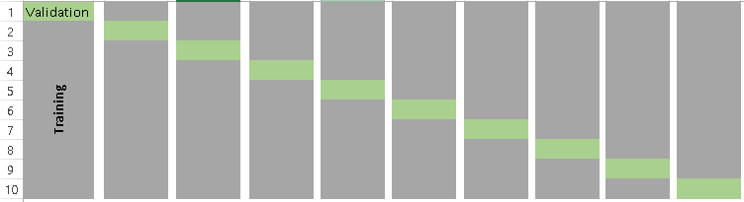
k-fold cross validation

Slide 49
Steps-k-fold cross validation
Randomly split your entire dataset into k”folds”
For each k-fold in your dataset, build your model on k – 1 folds of the dataset. Then, test the model to check the effectiveness for kth fold
Record the error you see on each of the predictions
Repeat this until each of the k-folds has served as the test set
The average of your k recorded errors is called the cross-validation error and will serve as your performance metric for the model

Slide 50
How to choose the right value of k?
Always remember, a lower value of k is more biased, and hence undesirable.
On the other hand, a higher value of K is less biased, but can suffer from large variability.
It is important to know that a smaller value of k always takes us towards validation set approach, whereas a higher value of k leads to LOOCV approach.

Slide 51
Stratified k-fold cross validation
Stratification is the process of rearranging the data so as to ensure that each fold is a good representative of the whole.
For example, in a binary classification problem where each class comprises of 50% of the data, it is best to arrange the data such that in every fold, each class comprises of about half the instances.

Slide 52
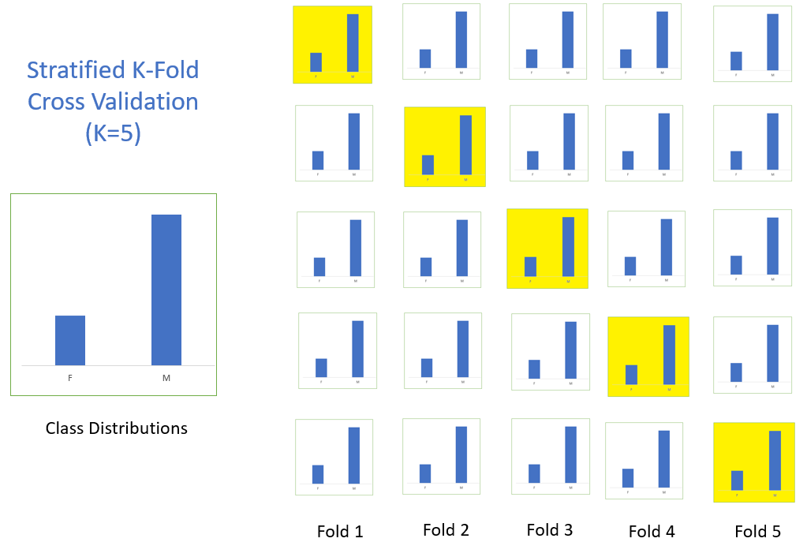
Stratified k-fold cross validation

Slide 53


